Slide 1

Exploring Long-Term Temperature Forecasts CNNs to Attention-Enhanced ConvLSTMs
Team 21
Dorian Boucher
-
49004563
Johannes Gungaard
-
49004571
Philipp Peter
-
49004549
Thomas Renaud
-
49004578
Notes:
Hello, today I will present you our project : Exploring Long Term Temperatures forecasts, from CNNs to attention enchanced ConvLSTMs

Slide 2
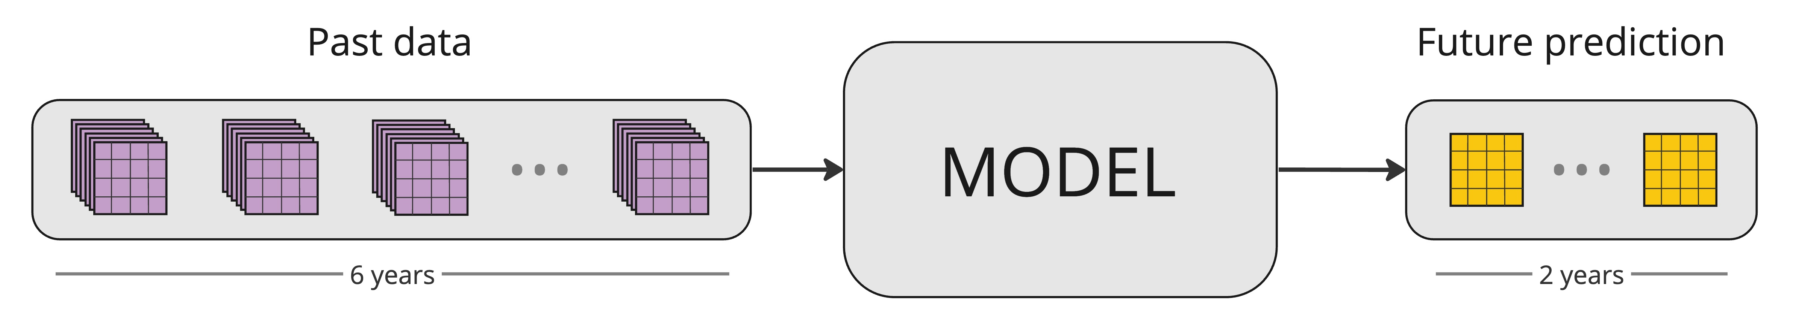
Objective
“Predict monthly average temperature on Long Range Scale over South Korea.”
Figure 1. Overall workflow of the proposed temperature forecasting model.
Notes:
The objective of our project is to predict the monthly average temperature on long range scale over a sub region which will be south korea. In this vizualisation is described the worklow of our model : based on 6 years of weather data, we predict only the average temperature over a month for the next 2 years.

Slide 3

Importance of Temperature Forecasting
Sectoral Relevance: Direct impacts on agriculture, energy, and transportation.
Climate Change Indicator: Temperature trends key for global climate response.
Localized Impact: Accurate regional forecasts vital for community management.
* Figure extracted from [1]
Notes:
This project is motivated by the importance of climate change. Because temperature trends are the key to understand the direct impacts on all sectors, we want to create a model that helps understand them on a local scale.

Slide 4
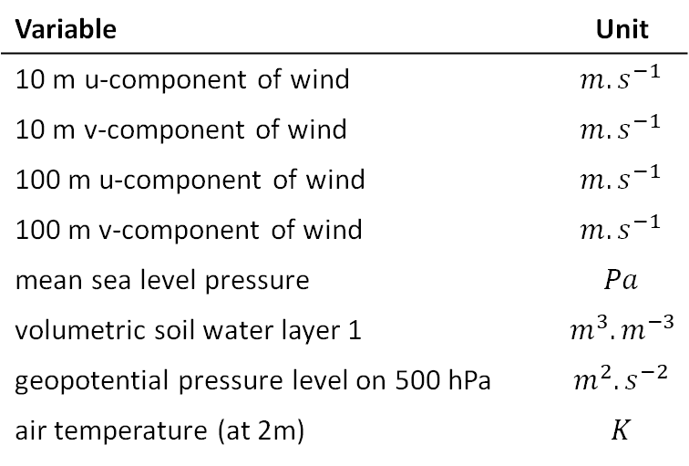

Feature Selection
Table 1. Variables kept after feature selection.
Data Collection:
ERA5 Reanalysis data set
1st January 1940 to present
Area:
Region: South Korea, 378 Stations
[34°N, 38°N] & [125°W, 130°E]
Feature Selection:
8 features in total from Fister et al. [2]
Variable | Unit
10 m u-component of wind | $$m.s^{−1}$$
10 m v-component of wind | $$m.s^{−1}$$
100 m u-component of wind | $$m.s^{−1}$$
100 m v-component of wind | $$m.s^{−1}$$
mean sea level pressure | $$Pa$$
volumetric soil water layer 1 | $$m^{3}.m^{−3}$$
geopotential pressure level on 500 hPa | $$m^{2}.s^{−2}$$
air temperature (at 2m) | $$K$$
1st 7th 13th 19th 25th
$$\overline{month}$$
Notes:
In order to do so, we selected 8 features from the ERA5 dataset, that consists on data from the 1st of january to present. Here are described the features that we took.

Slide 5
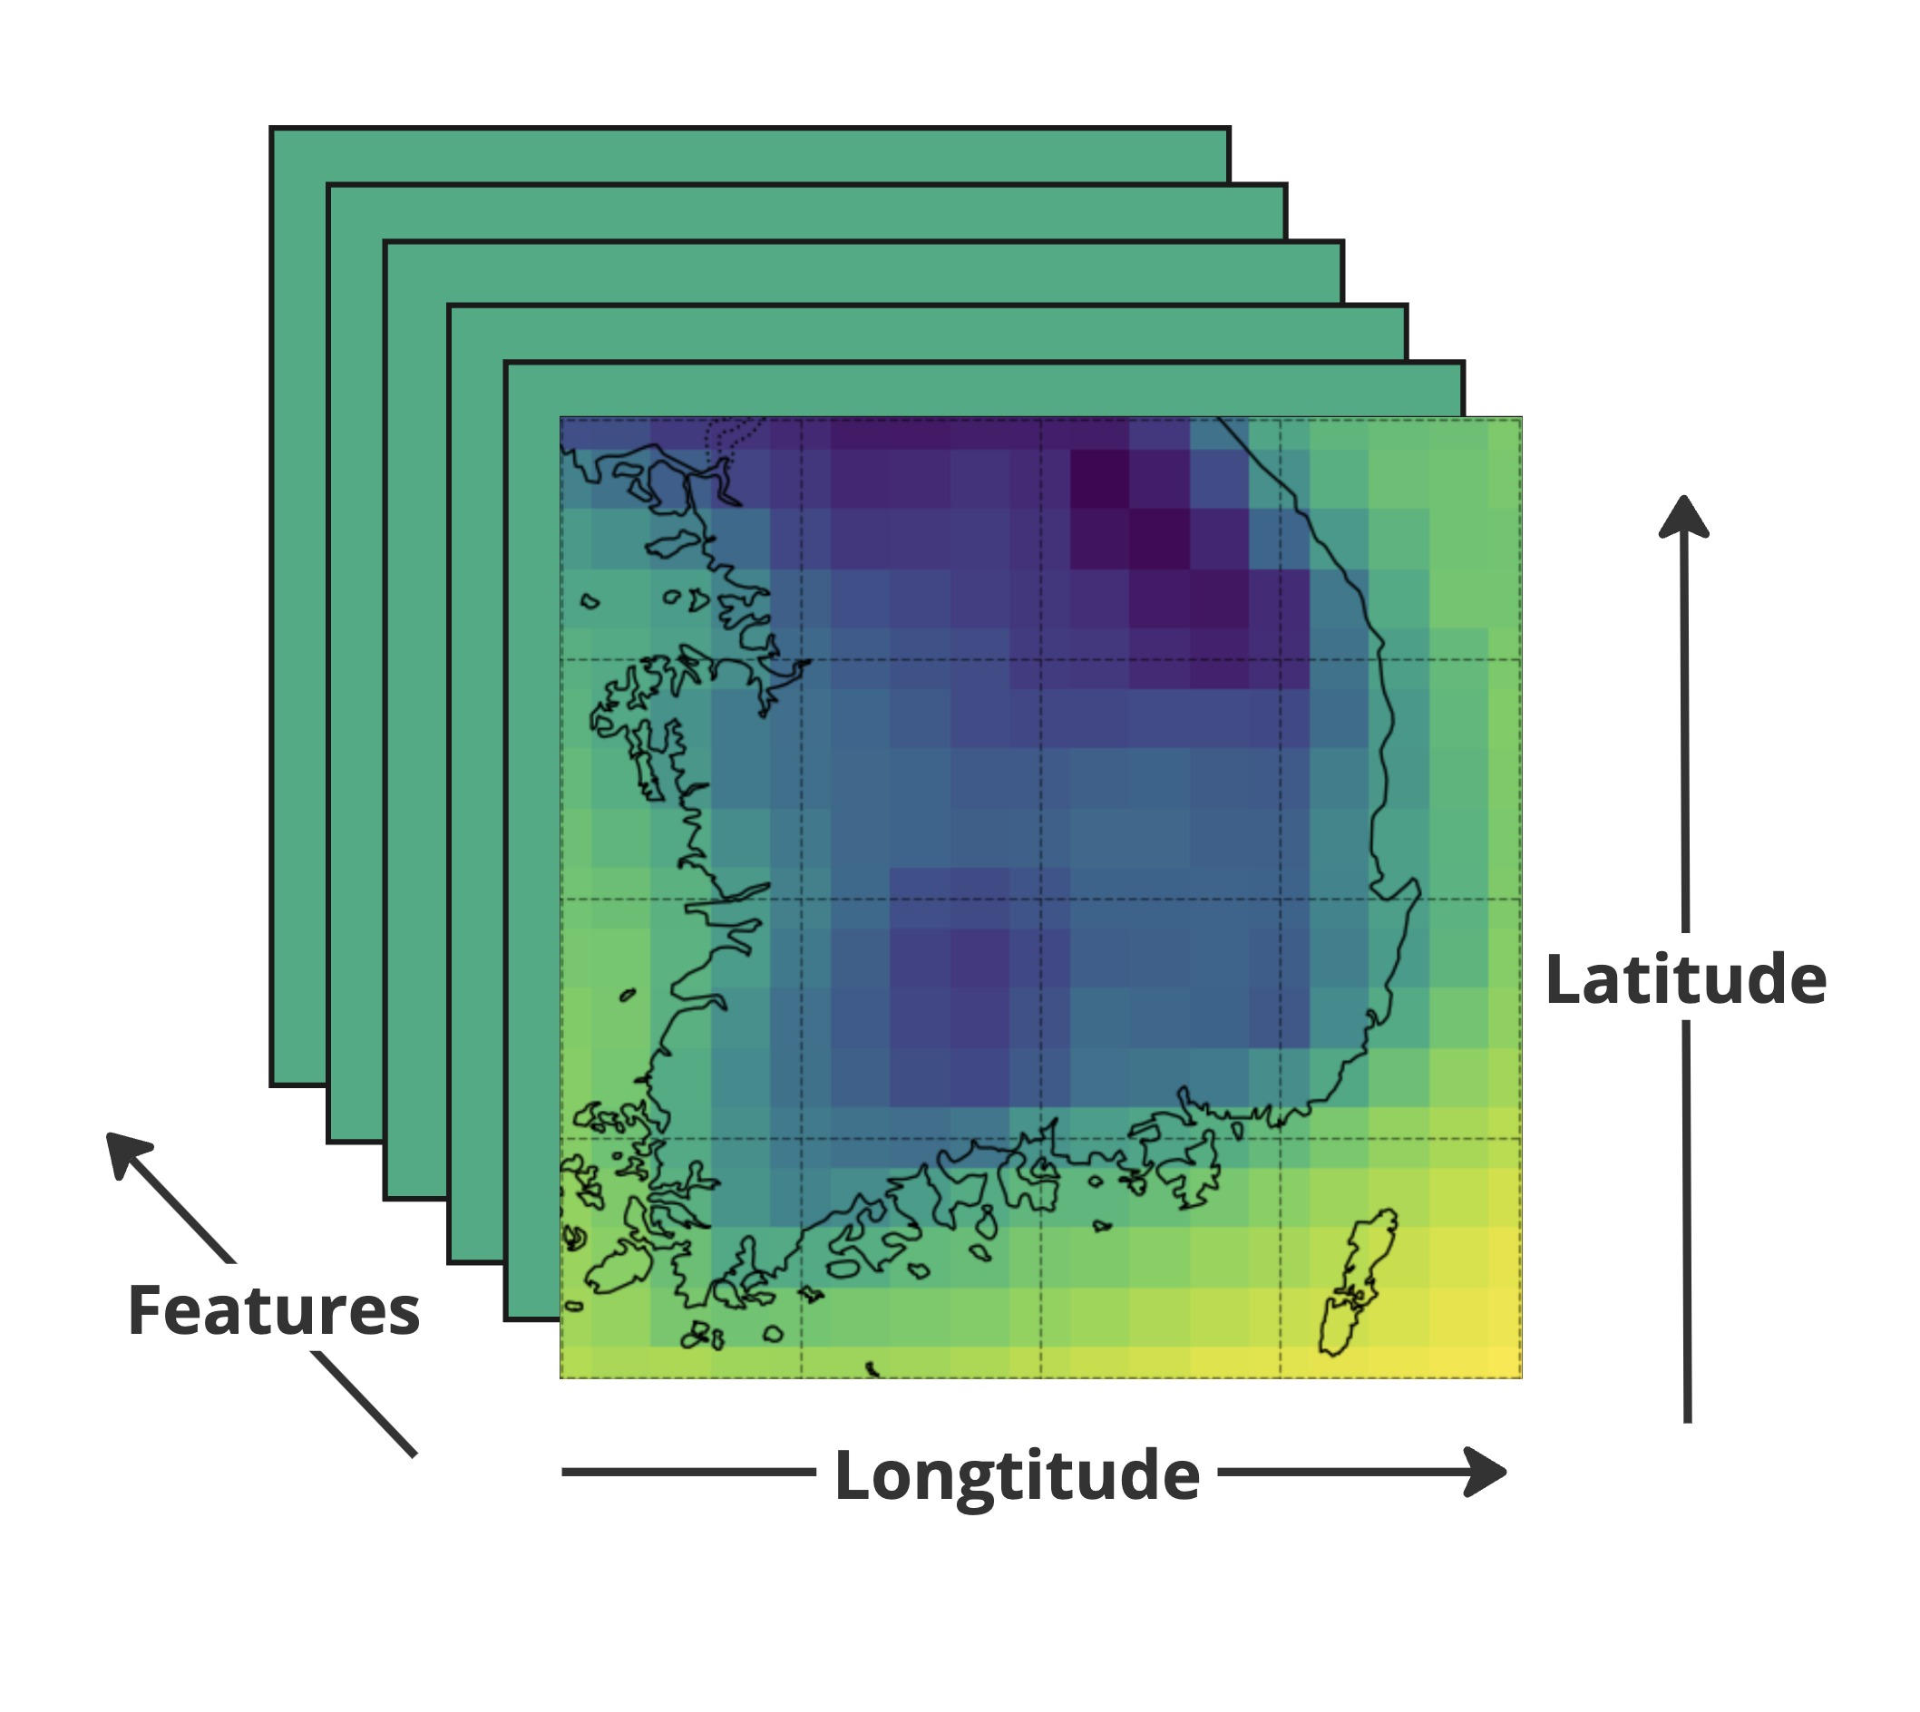
Preprocessing Dataset as Supervised Time Series
Data Collection:
ERA5 Reanalysis data set
1st January 1940 to present
Area:
Region: South Korea, 378 Stations
[34°N, 38°N] & [125°W, 130°E]
Feature Selection:
8 features in total from Fister et al. [2]
Figure 2. Shape of preprocessed data.
Notes:
We therefore obtain a dataset that can be represented like this : all of the features (such as temperature or wind speed) corresponding to a specific date, are taken over all of South Korea latitudes and longitudes availables.

Slide 6


Preprocessing Dataset as Supervised Time Series
$$F_{j} := \frac{1}{10}\sum_{i∈[1st, 7th, 13th, 19th, 25th] }{F_{i,j}} , (j=1,2,…8)$$
Data Collection:
ERA5 Reanalysis data set
1st January 1940 to present
Area:
Region: South Korea, 378 Stations
[34°N, 38°N] & [125°W, 130°E]
Feature Selection:
8 features in total from Fister et al. [2]
$$\overline{month}$$
Notes:
We then take the average over a month for all of the features, and we then get our dataset.

Slide 7
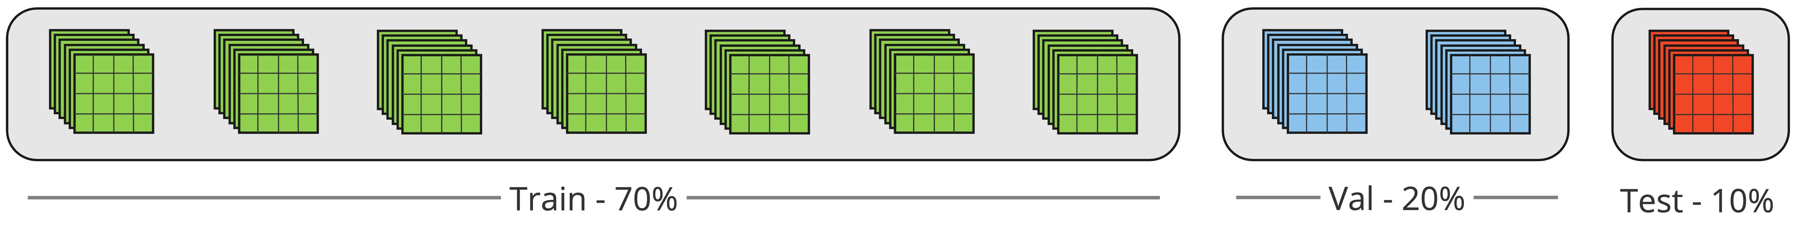
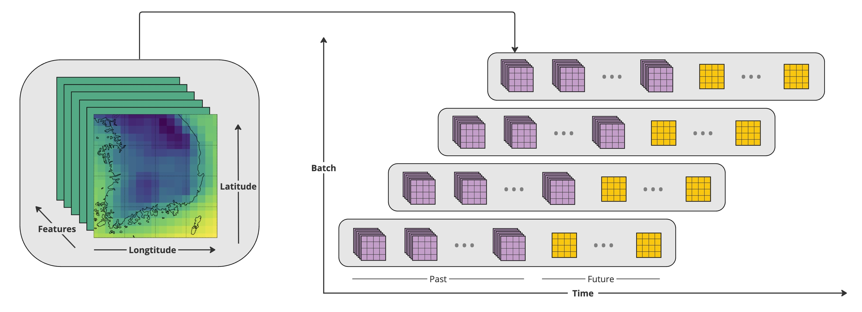
Preprocessing Dataset as Supervised Time Series
Data splitting
Figure 3. Visual representation of the splitting process.
Notes:
To train our model, we decided to split our dataset into train, validation and test set which represents 70-20 and 10 % of the dataset. This dataset is then converted to past and future sequences that are composed of 6 years of past data, and the 2 following years. In the end, each of the sequences are created by shifting the starting data point by 1 month.

Slide 8
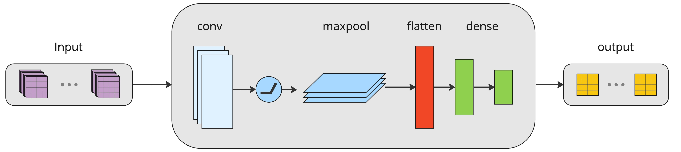
CNN Architecture
Figure 4. Architecture of the CNN network.
CNN(
(conv): Conv2d (8, 32, kernel_size=(3, 3), stride=(1, 1), padding=(1, 1))
(relu): ReLU
(maxpool): MaxPool2d (kernel_size=2, stride=2, padding=0, dilation=1, ceil_mode=False)
(dense 1): Linear (in_features=2560, out_features=64, bias=True)
(dense 2): Linear (in_features=64, out_features=4284, bias=True)
)
Notes:
After obtaining our Sequence data, we could create our models. This first one that we made is a CNN based model. This one is composed of a convolutionnal layer, followed by a relu activation function, a maxpooling layer and a flatten layer, and ends with 2 dense layers that create the desired shape of the output sequence.

Slide 9
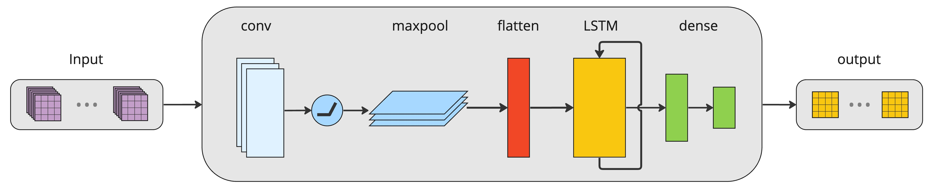
CNN-LSTM Architecture
Figure 5. Architecture of the ConvLSTM network.
ConvLSTM(
(conv1): Conv2d (8, 32, kernel_size=(3, 3), stride=(1, 1), padding=(1, 1))
(relu): ReLU
(pool): MaxPool2d (kernel_size=2, stride=2, padding=0, dilation=1, ceil_mode=False)
(lstm): LSTM (11424, 64, batch_first=True, bidirectional=True)
(dense 1): Linear (in_features=128, out_features=64, bias=True)
(dense 2): Linear (in_features=64, out_features=4284, bias=True)
)
Notes:
However, because the purpose of the model is to predict over long time data, we created another model that would be able to capture better the time aspect of our data. Therefore, we added to the CNN, a LSTM layer between the flatten layer and the dense layers.

Slide 10
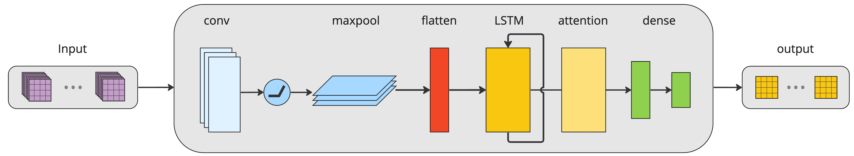
CNN-LSTM + Attention Architecture
Figure 6. Overall architecture of the ConvLSTM + Attention network.
CNN-LSTM Attention(
(conv): Conv2d (8, 32, kernel_size=(3, 3), stride=(1, 1), padding=(1, 1))
(relu): ReLU
(pool): MaxPool2d (kernel_size=2, stride=2, padding=0, dilation=1, ceil_mode=False)
(lstm): LSTM (11424, 64, batch_first=True, bidirectional=True)
(attention): ProbSparseAttention
(dense 1): Linear (in_features=3200, out_features=64, bias=True)
(dense 2): Linear (in_features=64, out_features=4284, bias=True)
)
Notes:
Finally, we created a third model with a prob sparese attention layer. Motivated by the Informer model, we implemented the attention layer right after the output of the LSTM layer. This gives us the following model architecture that you can see on this slide

Slide 11
Results - Comparative Performance
Table 2. Evaluation results on ERA5 test set
Model | RMSE | MAE | MAPE
CNN | 0.2983 | 0.2411 | 1.6127
CNN-LSTM | 0.2492 | 0.2003 | 1.4153
CNN-LSTM-Attention | 0.3281 | 0.2668 | 1.8888
Notes:
After training, and validating our data, we were able to obtain the followings results. The metrics that we used are the RMSE, the MAE and the MAPE as they widly used in Timeseries forecasting with the lower the value, the better it is. As you can see on this table, the best model that we obtain is the CNN-LSTM on all the metrics. The least perfomant one on the other hand is the one with Attention mechanism.

Slide 12
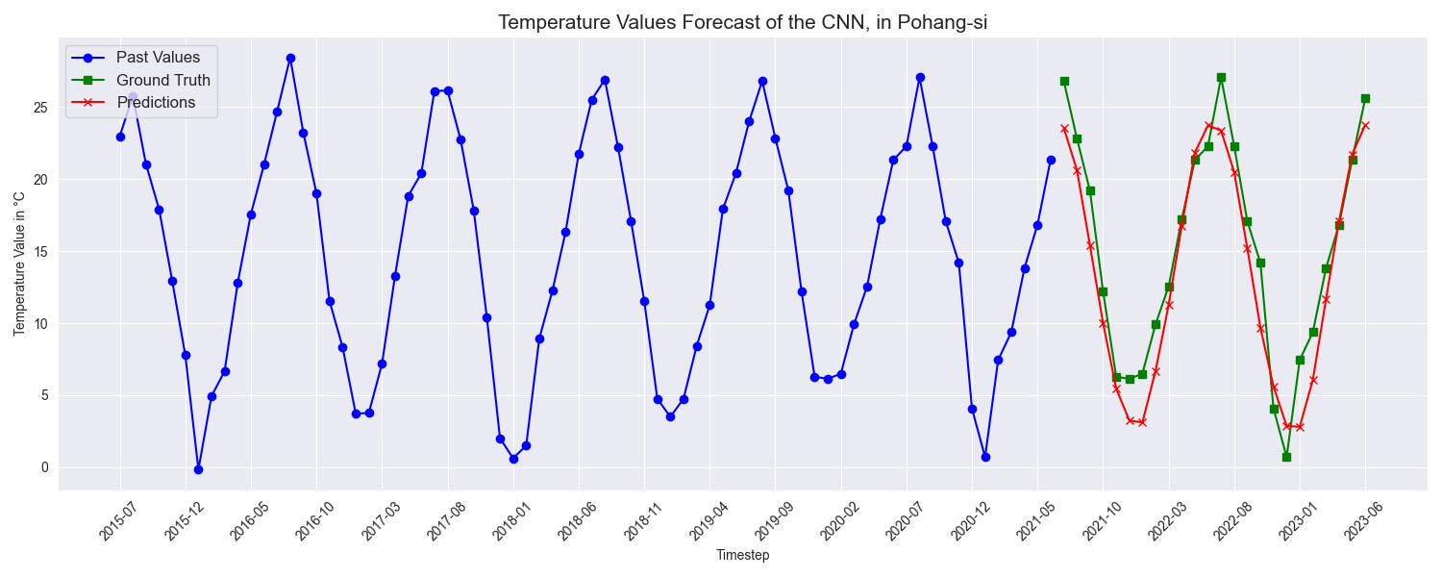
Results - CNN
Figure 7. Example forecast of CNN network.
Notes:
Here is an example of the temperature forecast in Pohang that we obtain with the CNN model, in blue are the past temperatures values, in green are the ground truth values, and in red are the predictions made by the model. As you can see here, the tendency of the model is fitting well with the ground truth.

Slide 13
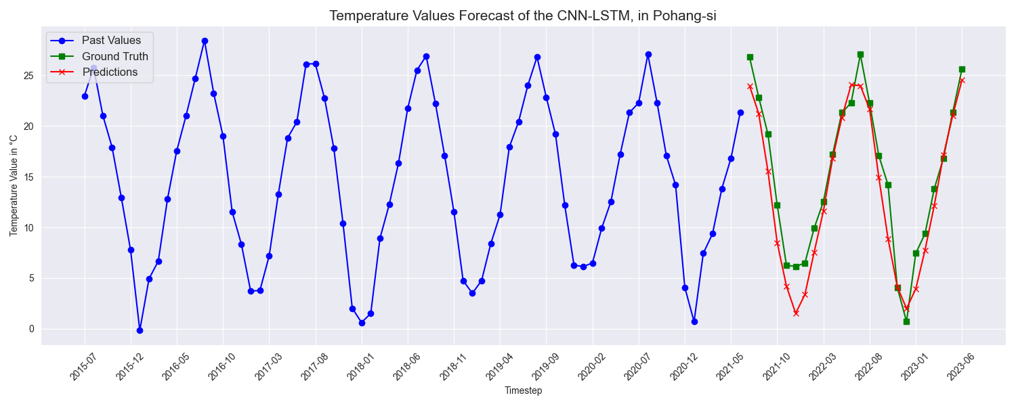
Results - Conv-LSTM
Figure 8. Example forecast of Conv-LSTM network.
Notes:
The ConvLSTM on his side, forecast a bit better the future temperatures values.

Slide 14
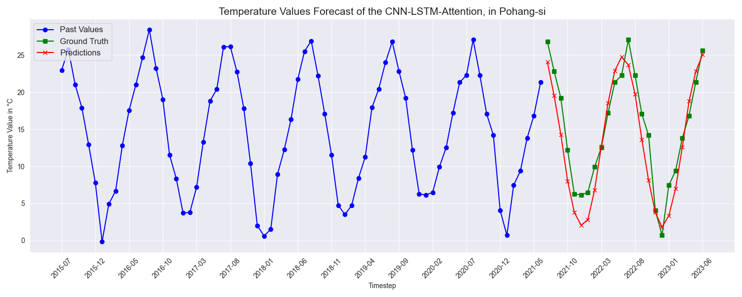
Results - Conv-LSTM + Attention
Figure 9. Example forecast of Conv-LSTM + Attention network.
Notes:
Finally with the Attention based model, the forecast is a bit shifted, but follows fairly well the real future values in Pohang.

Slide 15
Analysis - Model Performance Insights
CNN LSTM Superiority:
Superior performance in the task of generating long-term temperature forecasts
Inherent ability to capture and retain information over extended time sequences
Basic Convolutional Efficacy:
Exhibits limitations in learning long-term temporal dependencies
Quicker learning process, at the cost of performance
Attention Mechanism Setback:
Addition of attention layer has resulted in underperformance.
This setback highlights the delicate balance required when introducing sophisticated components to a model
Notes:
In the end, we observe that best model that we obtain is the CNN LSTM. This one was able to generate the best long term temperature forecasts. On his side, the basic CNN model exhibits some limitations in learning long-term temporal dependencies. However, because the model is smaller, it is the fastest to train. On the other hand, the Attention based model has resulted in underperformance and highlights the balance required when introduciong sophisticated components to a model

Slide 16
Conclusion
Reduced inference time compared to traditional Numerical Weather Prediction (NWP)
Accessible and precise forecasts for practical applications
Efficient approach to understand and anticipate climatic trends over longer periods.
Notes:
In conclusion, we were able to obtain models that are able to forecast the temperature values over the next years much faster than Numerical Weather Prediction simulation, that requires hours if not days to give results.
This then make more accessible precise forecasts for pratical applications which is a very efficient approach to understand and anticipate trends over longer periods.

Slide 17
Thank you for listening

Slide 18
References
[2] Fister, D., Pérez-Aracil, J., Peláez-Rodríguez, C., Del Ser, J., and Salcedo-Sanz, S., "Accurate long-term air temperature prediction with Machine Learning models and data reduction techniques," in Applied Soft Computing, vol. 136, pp. 110118, 2023. DOI: 10.1016/j.asoc.2023.110118. [Online]. Available: https://www.sciencedirect.com/science/article/pii/S1568494623001369.
Notes:
NO CLICK!!!

Slide 19
Image References
[1] Treescape, "Global Warming: Unveiling the Unsettling Consequences," Treescape Planet, June 2023. [Online]. Available: https://treescapeplanet.org/global-warming-unveiling-the-unsettling-consequences/. [Accessed Dec. 10, 2023].

